Slide 1


Minor Project-1
Title:
Sign Language Recognition System
Presented by:
R214220889 - Raghav Akshat Upadhyay
R214220912 Rakshit Pratap Singh
Mentored By
Dr .Surbhi Saraswat

Slide 2
Content
Introduction
Literature Review
Objectives
Methodology
Working Models
Results
Conclusion
References
Colour Code:
Synopsis: Red
Mid term: Orange
End Term: Purple
Note: The Following presentation will have all the content of the later.

Slide 3
Introduction
Sign Language is one of the most important form of communication for deaf and dumb people. It allows them to express themselves , ask for aid in times of need etc.
But for normal people it is hard to communicate via the means of sign language as it is hard to learn and difficult to perform.
Most implementations for this task have used depth maps generated by depth camera and high resolution images.
This project proposes a sign language recognition system on American sign language using the deep learning technique Convolutional Neural Networks.

Slide 4
Technical Concepts (Algorithms) used
Convolutional Neural Networks: It is a Deep Learning algorithm which can take in an input image, assign importance (learnable weights and biases) to various aspects/objects in the image and be able to differentiate one from the other. The pre-processing required in a CNN is much lower as compared to other classification algorithms. Initially we plan to create a simple neural network with one convolution layer then moving forward we will apply parameter tuning on the model using multiple layers, Batch Normalization, and Dropout layer.

Slide 5
Motivation
According to a few reports, around 75 million people in the world are deaf or mute and they have trouble communicating with people without such problem. Hand sign are the primary way for them to communicate. Hand signs are tough to be understood by people without such issues and hence an easier way to establish communication between them is required.
This goal is further motivated by the isolation that is felt within the deaf community. Loneliness and depression exists in higher rates among the deaf population, especially when they are immersed in a hearing world [1]. Large barriers that profoundly affect life quality stem from the communication disconnect between the deaf and the hearing. Some examples are information deprivation, limitation of social connections, and difficulty integrating in society [2].
As English one of the most widely used languages not only in India but also all across the world , this project will serve to be highly beneficial for differently abled all across the world.
Problem Statement
Sign Language recognition system using CNN on American Sign Language Dataset
Area of Application
Life style and Healthcare of differently abled.

Slide 6
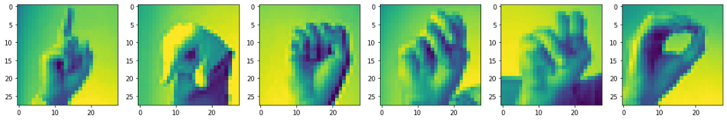
Dataset and Input Format
This project works upon American Sign Language MNIST dataset which is publicly available on the Kaggle platform. https://www.kaggle.com/datasets/datamunge/sign-language-mnist.
The dataset consists of hand sign images in pixel values of various alphabets of the English Language.
The dataset format is patterned to match closely with the classic MNIST. Each training and test case represents a label (0-25) as a one-to-one map for each alphabetic letter A-Z (and no cases for 9=J or 25=Z because of gesture motions). The training data (27,455 cases) and test data (7172 cases)
c) Sample Data Image

Slide 7
Literature Review
Cite Related work & Inference from literature
In the year 2018, Konstantinidis, D., Dimitropoulos, K., & Daras, P. published a paper SIGN LANGUAGE RECOGNITION BASED ON HAND AND BODY SKELETAL DATA [3]where they found that a structured system of hand gestures with clear meanings used by hearing-impaired people to communicate in daily life is known as a sign language
In September, 2019 Danielle Bragg, Oscar Koller, Mary Bellard, Larwan Berke, Patrick Boudreault, et al.. Sign Language Recognition, Generation, and Translation: An Interdisciplinary Perspective.paper,[4] In that paper, Around the world, there are more than 300 different sign languages. Even though there are numerous distinct sign languages, only a small portion of the community is conversant in any of them, making it challenging for people with special needs to freely interact with the general public. SLR gives people a way to communicate in sign language even if they don't know it. It interprets a gesture into a language that is widely used, like English.
In the year 2018 Rosero-Montalvo, P.D., Godoy-Trujillo, P.E., Flores-Bosmediano, E., Carrascal-García, J., Otero-Potosi, S., Benitez-Pereira, H., & Peluffo-Ordóñez, D.H. (2018). Sign Language Recognition Based on Intelligent Glove Using Machine Learning Techniques. 2018 IEEE Third Ecuador Technical Chapters Meeting (ETCM), 1-5. and they found that Sign Language Recognition is a fairly broad area of study, and while much work has been done in this area, there are still many issues that need to be resolved. The use of machine learning techniques enables computerised systems to make decisions based on data and experience. Two datasets are required for the classification algorithms: a training dataset and a testing dataset.

Slide 8
The classifier learns from the training set's experiences, and the model is evaluated using the testing set [5]. Numerous authors have created effective strategies for data collection and classification

Slide 9
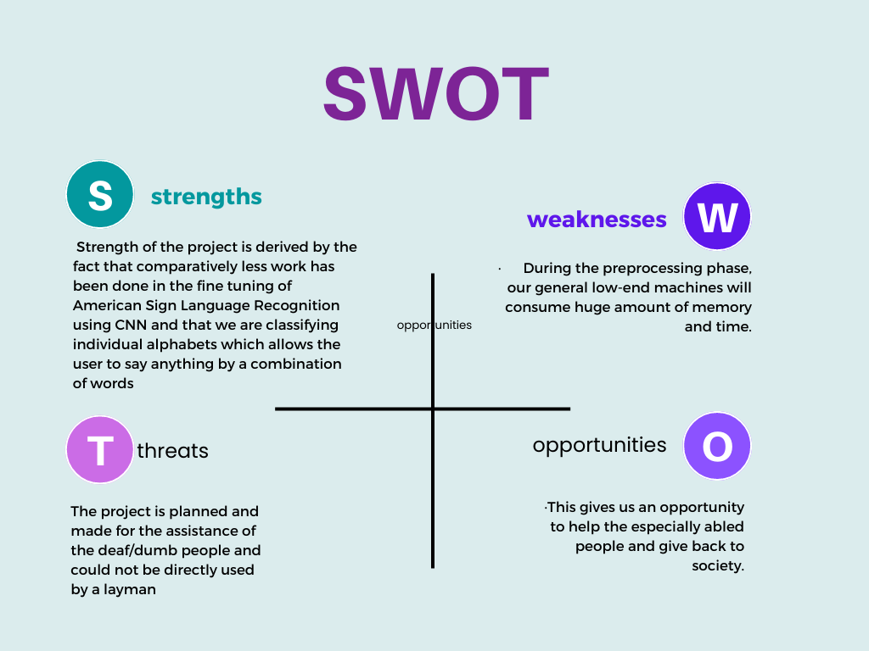
SWOT Analysis

Slide 10
Objective
Main Objective
Our main objective is to do a comparative study on Convolutional Neural Networks algorithm over ASL data and find ways to classify them
Our objective is to perform sign language recognition using Cnn algorithm and using OpenCV to get images from user
Sub Objective
For pre-processing the SAR data we’ll be performing:
Data pre processing
Model fine tuning
Data Augmentation

Slide 11
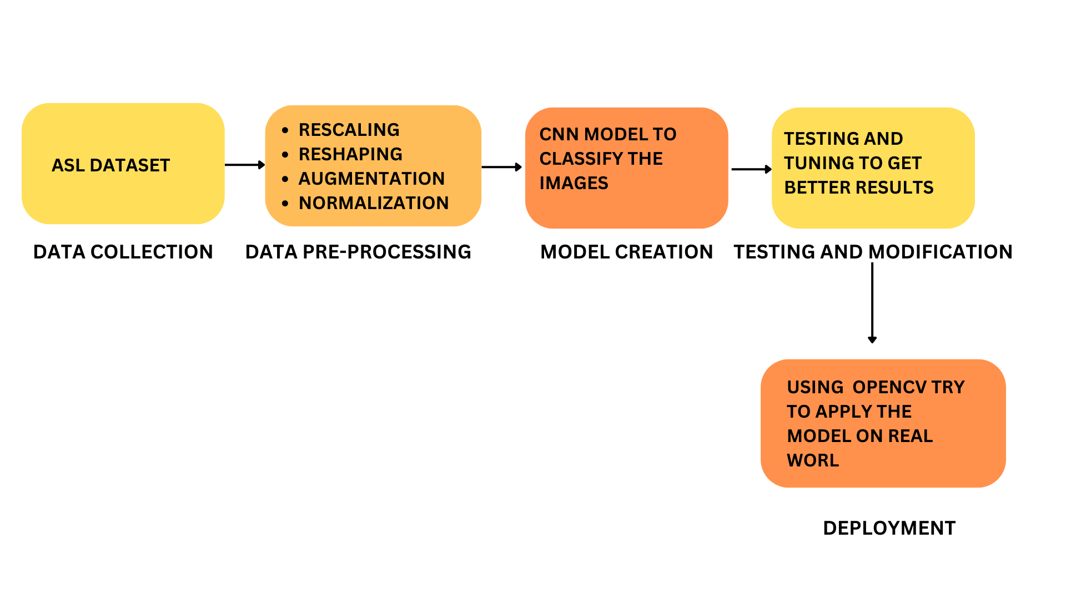
Methodology
Reference Software Model

Slide 12
Methodology
Steps
Acquiring of dataset- The project works upon American Sign Language dataset which is publicly available on https://www.kaggle.com/datasets/datamunge/sign-language-mnist .
Preprocessing of Dataset- Includes rescaling ,reshaping the image size to usable format ,converting images to pixel value array. Preprocessing can also include augmentation for more robust model generation
Data Decomposition- Conversion of real time data from required to required state
Sign Detection– building models on the data and perform tuning on it to get the best results
Testing and Analysis- The code will be tested for performance and errors.

Slide 13
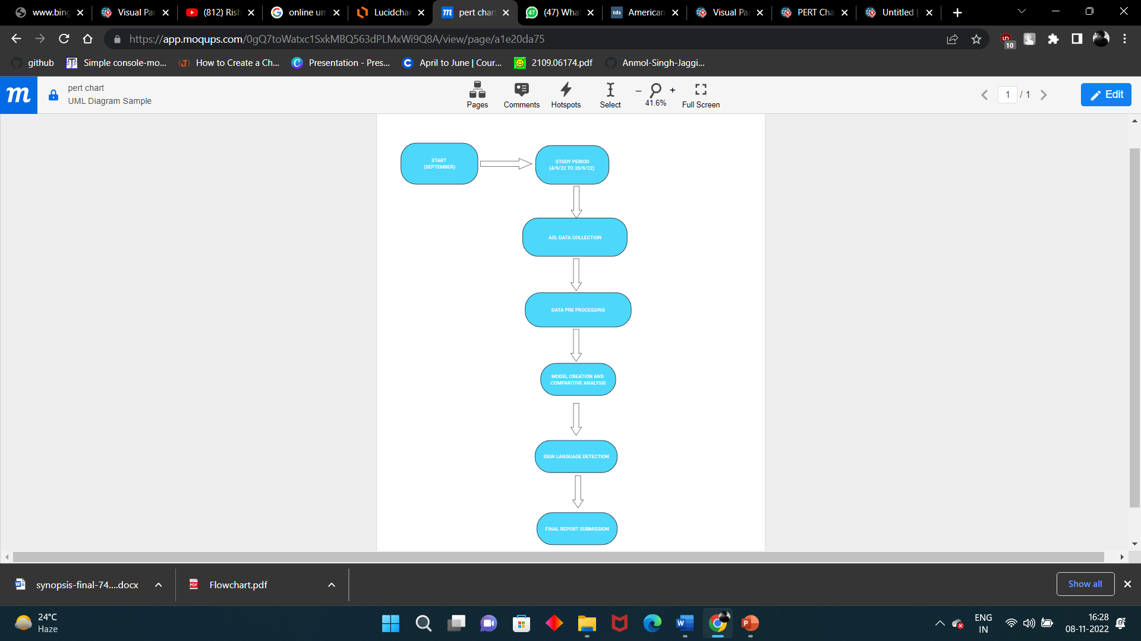
Timeline

Slide 14
Deliverable of each step or phase
Acquiring of Dataset
This project works upon Sentinel- 1 dataset which is publicly available on https://www.kaggle.com/datasets/datamunge/sign-language-mnist.The dataset consists of hand sign
Pixel values for American Sign Language dataset.
Data Pre-Processing
Preprocessing data is a common first step in any project to prepare raw data in a format that the AI model can accept. For example, we’ll be converting the image data to pixel format. we preprocess data to enhance desired features or reduce artifacts that can bias the AI model.

Slide 15
Deliverable of each step or phase
Data Decomposition
Converting the real time data will require us to collect the image from the user by using the OpenCv module of python , then we convert it to pixel values by using the PIL library of python
Sign Detection
Then we will create the model and try to tune it using certain parameters
Testing and Analysis
This step contains the conclusion, results and observations of the model after proper testing and analysis.

Slide 16
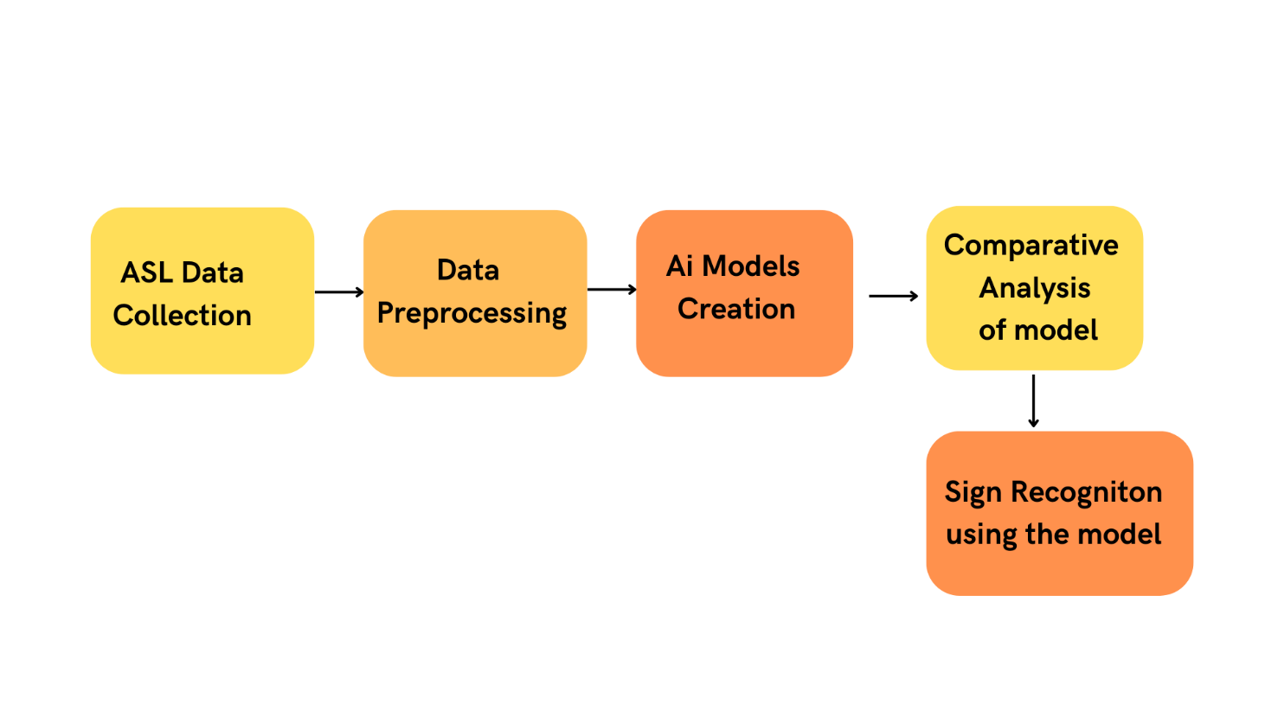
Working Model
Requirement Analysis- (Link of SRS)
https://docs.google.com/document/d/1Yyt69WDkV-EkuggL3dNbBgoMmtFk6KFZ/edit?usp=sharing&ouid=112943348027907141476&rtpof=true&sd=true
Technical Diagram (Flowchart)

Slide 17
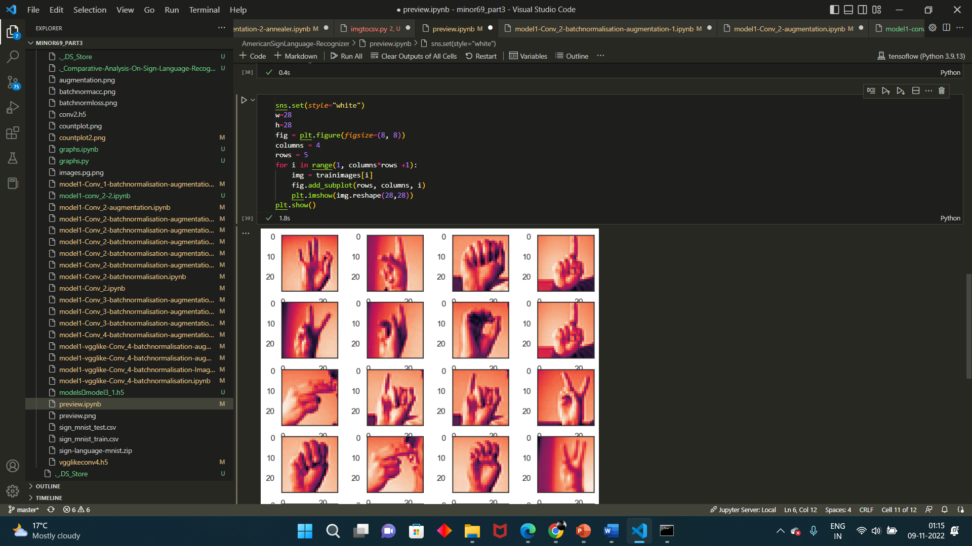
Working Model
Working Module

Slide 18
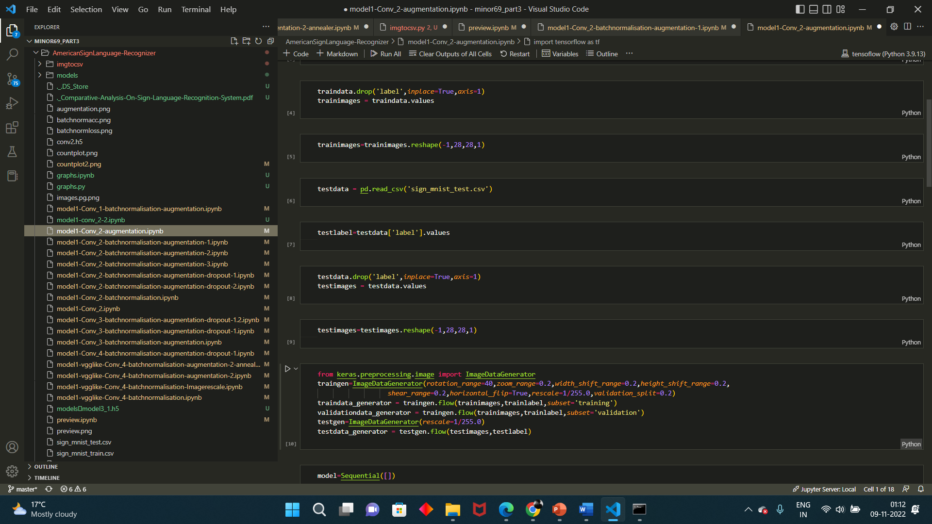
Working Model
Data Preprocessing

Slide 19
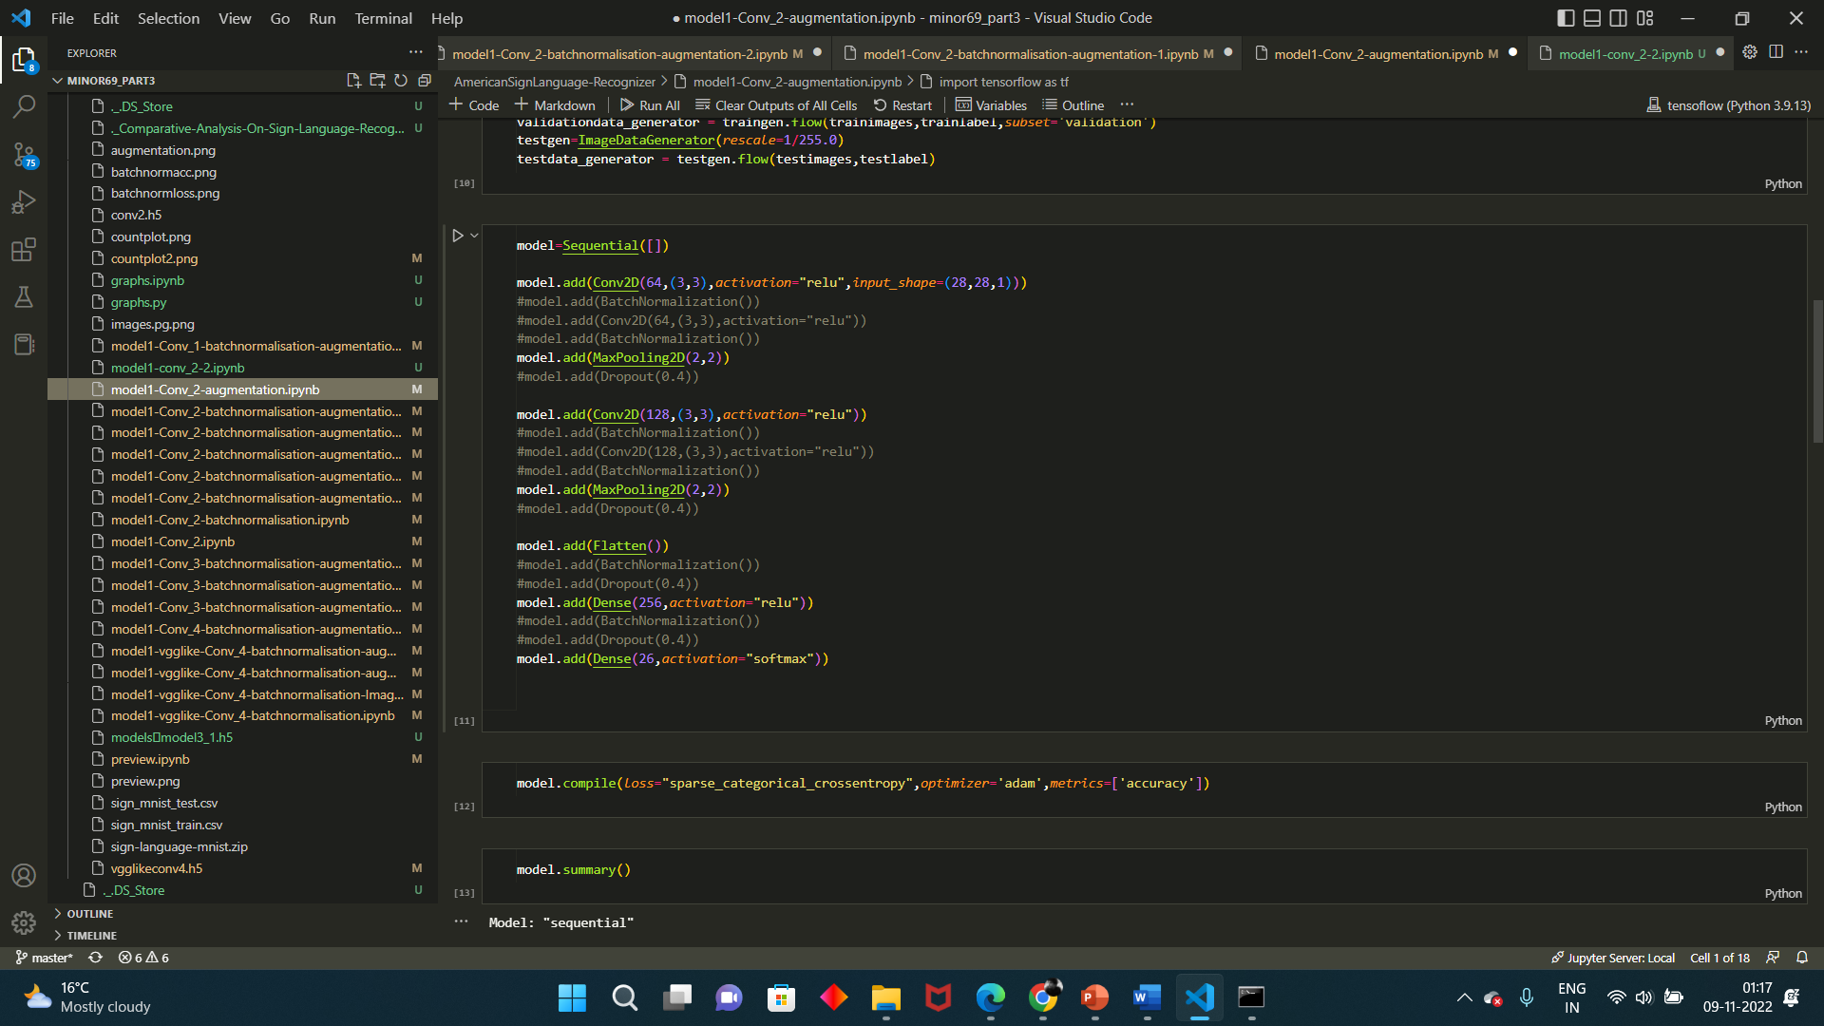
Working Model
Model Creation

Slide 20
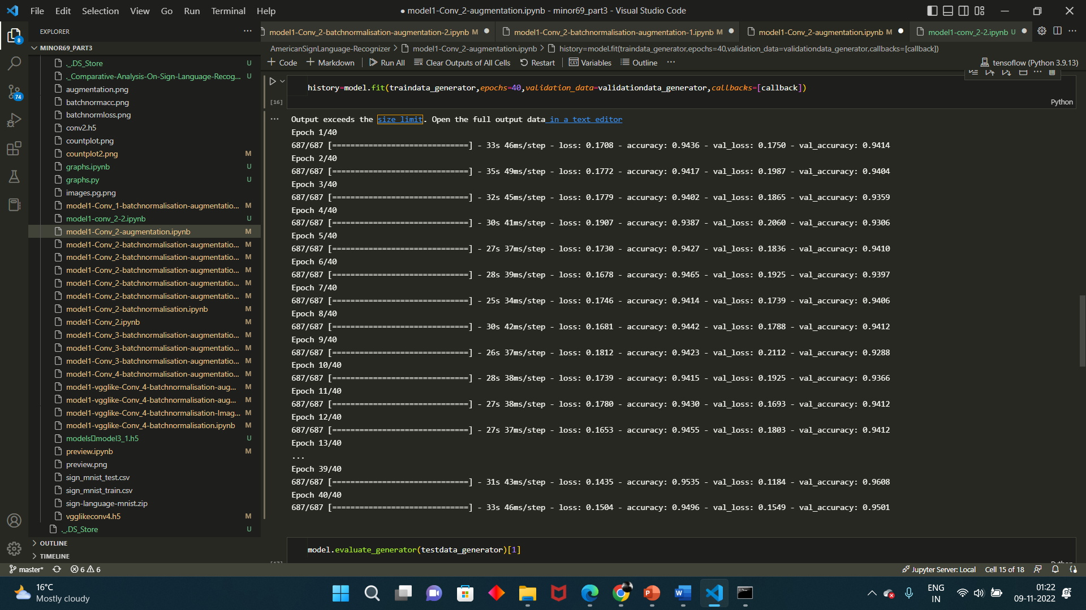
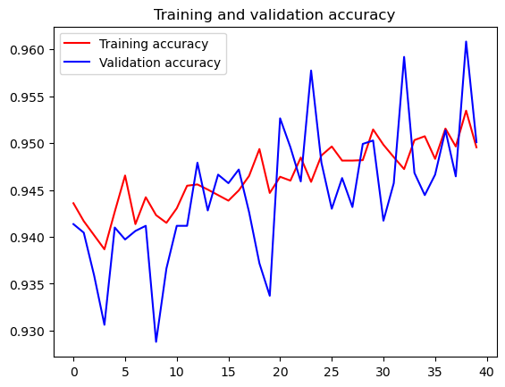
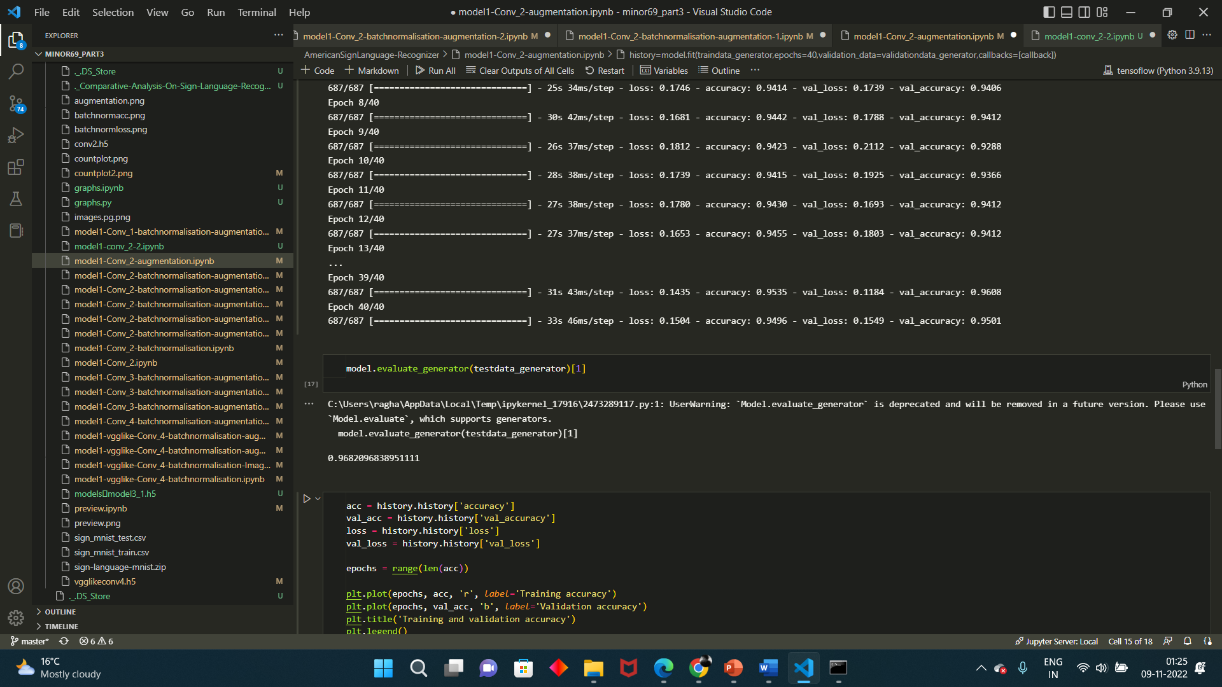
Working Model
Training and testing
Graph for accuracies

Slide 21
Working Model
Comparative analysis of models
Model | No. of Conv layers | Augmentation | Batch Normalisation | Dropout | Training Accuracy | Test Accuracy
1 | 1 | yes | yes | yes | 97.2 | 96.12
2 | 2 | no | no | no | 96 | 91.2
3 | 2 | yes | no | no | 94.96 | 96.82
4 | 2 | no | yes | no | 100 | 94.72
5 | 2 | yes | yes | no | 94.4 | 94.6
6 | 2 | yes | yes | no | 98 | 98.2
7 | 2 | yes | yes | no | 98 | 95.83
8 | 2 | yes | yes | yes(0.4) | 94.008 | 96
9 | 2 | yes | yes | yes(0.4,0.4) | 84.5 | 97.54
10 | 3 | yes | yes | No | 98.06 | 98.3
11 | 3 | yes | yes | Yes(0.4) | 90 | 93
12 | 3 | yes | yes | Yes 0.2 | 92.85 | 97.57
13 | 4 | no | yes | No | 98 | 96.29
14 | 4 | yes | yes | No | 98.06 | 98
15 | 4 | yes | yes | Yes0.4 | 98.9 | 97.4

Slide 22
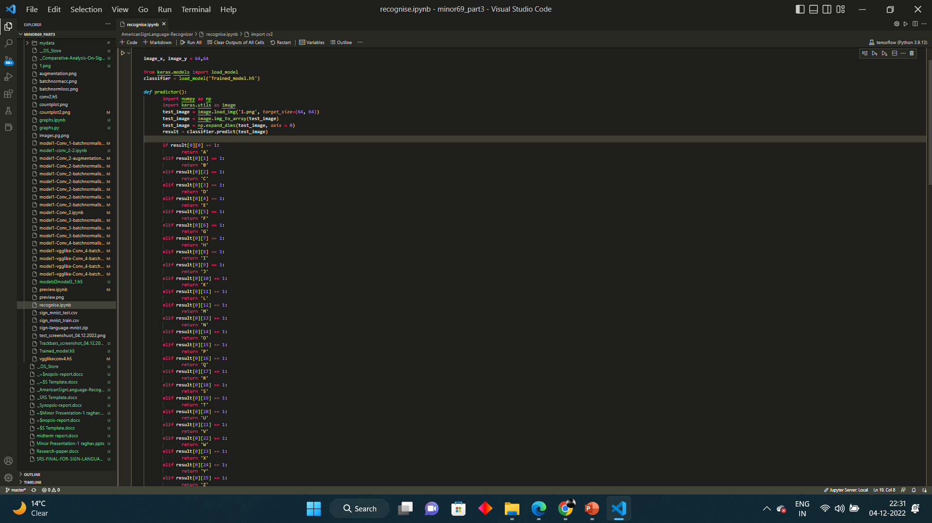
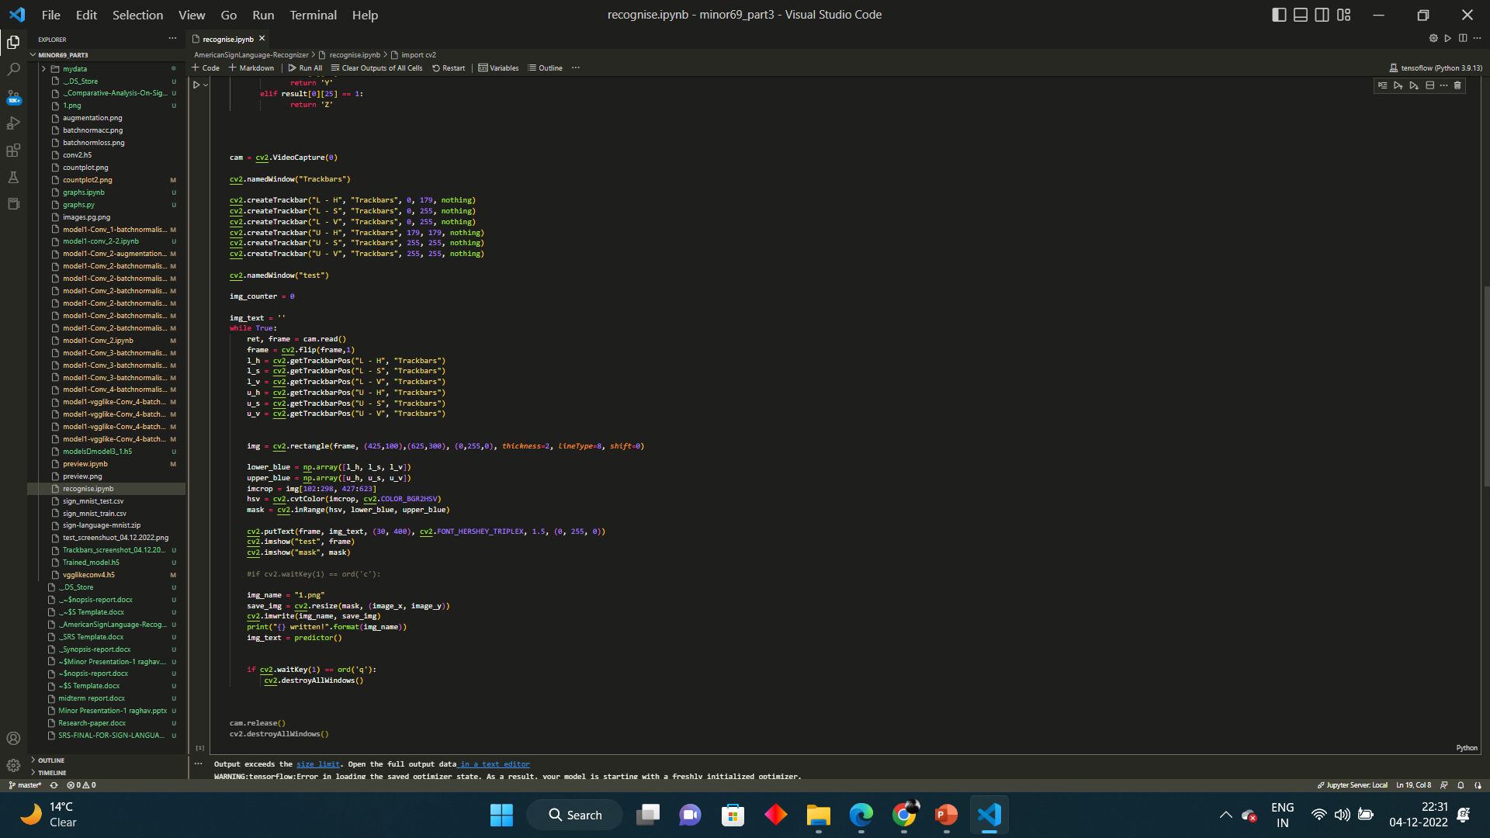
Working Model
Real time model working

Slide 23
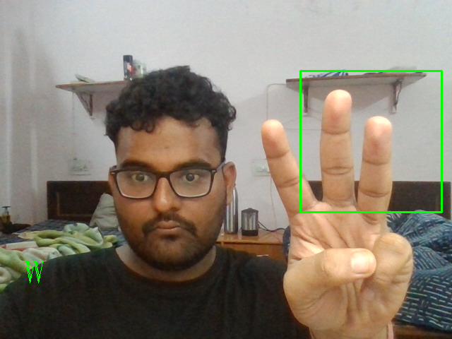
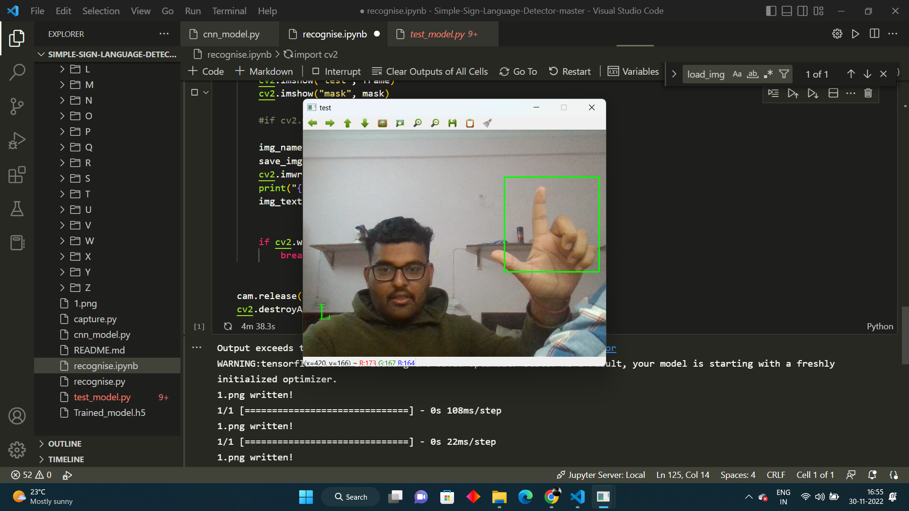
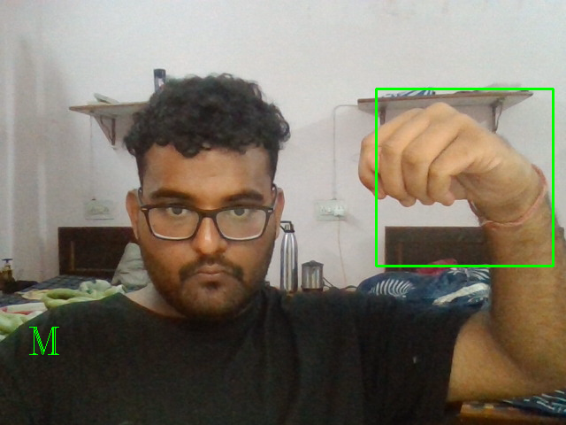

Slide 24
Objectives covered:
Justification of Objectives:
Objective | Status
Data preprocessing | completed
Model creation | completed
comparing accuracies | completed
real time data generation | completed

Slide 25
Conclusion
Future Scope:
Sign languages are kinds of visual languages that employ movements of hands, body and facial expression as a means of communication. Sign languages are important for specially-abled people to have a means of communication. Through it, they can communicate and express and share their feelings with others. The drawback is that not everyone possesses the knowledge of sign languages which limits communication. This limitation can be overcome by the use of automated Sign Language Recognition systems which will be able to easily translate the sign language gestures into commonly spoken language. In this paper, it has been done by TensorFlow object detection API. The system has been trained on the American Sign Language alphabet dataset. The system detects sign language in real-time. For data acquisition, images have been captured by a webcam using Python and OpenCV which makes the cost cheaper. The developed system is showing an average confidence rate of 72.45%. Though the system has achieved a high average confidence rate, the dataset it has been trained on is small in size and limited. In the future, the dataset can be enlarged so that the system can recognize more gestures. The TensorFlow model that has been used can be interchanged with another model as well. The system can be implemented for different sign languages by changing the dataset.

Slide 26
Reference
List of Cited Papers
Konstantinidis, D., Dimitropoulos, K., & Daras, P. (2018). SIGN LANGUAGE RECOGNITION BASED ON HAND AND BODY SKELETAL DATA. 2018 - 3DTV-Conference: The True Vision - Capture, Transmission and Display of 3D Video (3DTV-CON), 1-4.
Danielle Bragg, Oscar Koller, Mary Bellard, Larwan Berke, Patrick Boudreault, et al.. Sign Language Recognition, Generation, and Translation: An Interdisciplinary Perspective. The 21st International ACM SIGACCESS Conference on Computers and Accessibility, Oct 2019, Pittsburgh, United States. ⟨hal-0239z4580⟩
Rosero-Montalvo, P.D., Godoy-Trujillo, P.E., Flores-Bosmediano, E., Carrascal-García, J., Otero-Potosi, S., Benitez-Pereira, H., & Peluffo-Ordóñez, D.H. (2018). Sign Language Recognition Based on Intelligent Glove Using Machine Learning Techniques. 2018 IEEE Third Ecuador Technical Chapters Meeting (ETCM), 1-5.
Huang, J., Zhou, W., Zhang, Q., Li, H., & Li, W. (2018, January 30). Video-based Sign language recognition without temporal segmentation. arXiv.org. Retrieved October 15, 2022, from https://arxiv.org/abs/1801.10111

Slide 27
Thank You

